Slide 1
THE OSI MODEL

Slide 2
Network Models
Networks - combination of hardware and software that sends data from one location to another.
Hardware - physical equipment that carry signal
Software - Instruction sets
To make communications efficient,
Many components are involved.
Each with a specific function or service.

Slide 3
Layered Tasks
Hierarchy
 The complex task is broken into smaller subtasks
Services
 The higher layer uses the services of the lower layer

Slide 4
Example of Person-to-person communication
Cognitive : Defines purpose of message exchange
Linguistic : Provides common language
Physical : Physically transmits information between users

Slide 5
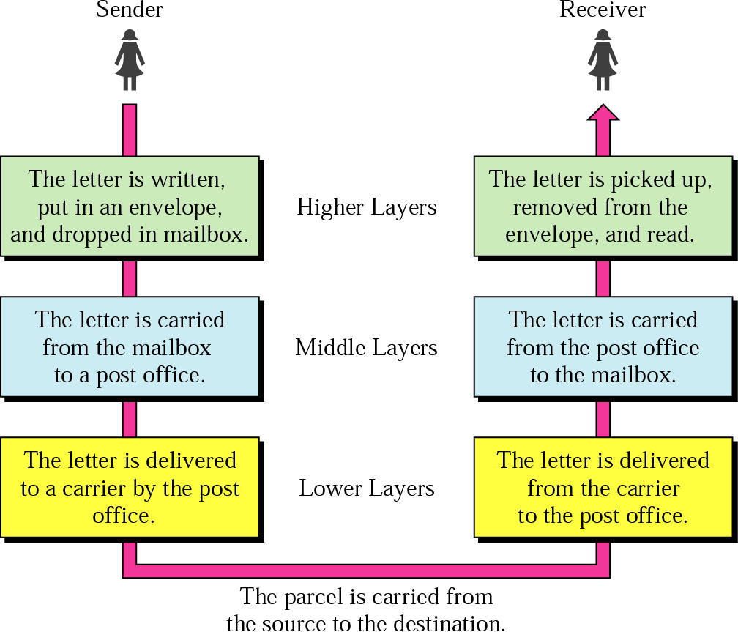
Example of Sending a letter

Slide 6
OSI Model
Open Systems Interconnection model.
ISO standard that covers all aspects of network communications.
It was first introduced in late 1970s.
Open System – Set of Protocols that allow any two systems to communicate.
7 layer theoretical model of how a protocol stack should be implemented

Slide 7
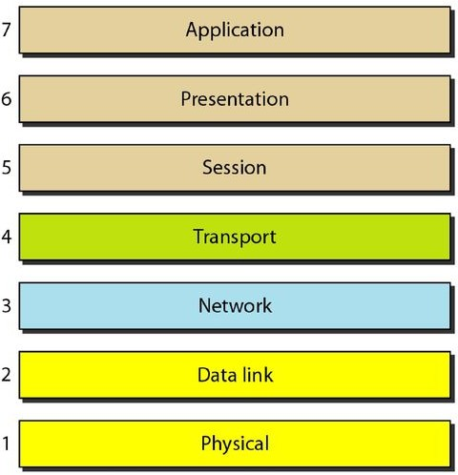
OSI Model
Physical Layer
Data Link Layer
Network Layer
Transport Layer
Session Layer
Presentation Layer
Application Layer
Each layer defines how data is treated and goes through different stages while traveling in network from one place to another.
All layer are used in end to end systems but only first three layers used in intermediate systems (NODE TO NODE DELIVERY).

Slide 8
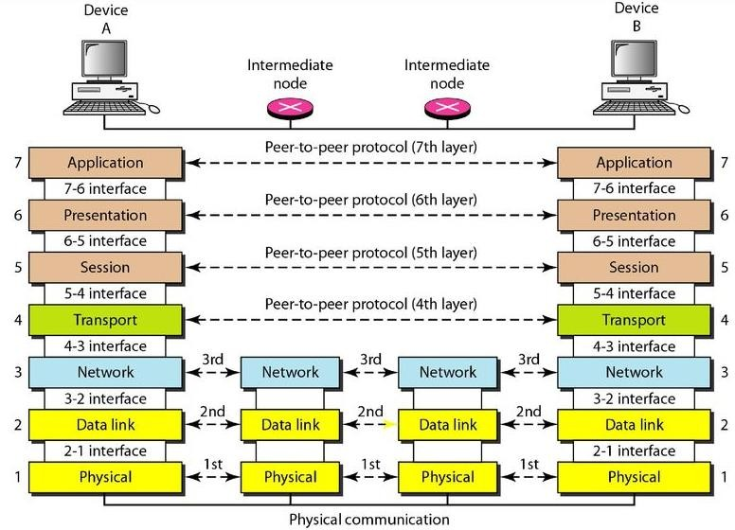
Interaction (Interface Connection) between layers in the OSI model

Slide 9
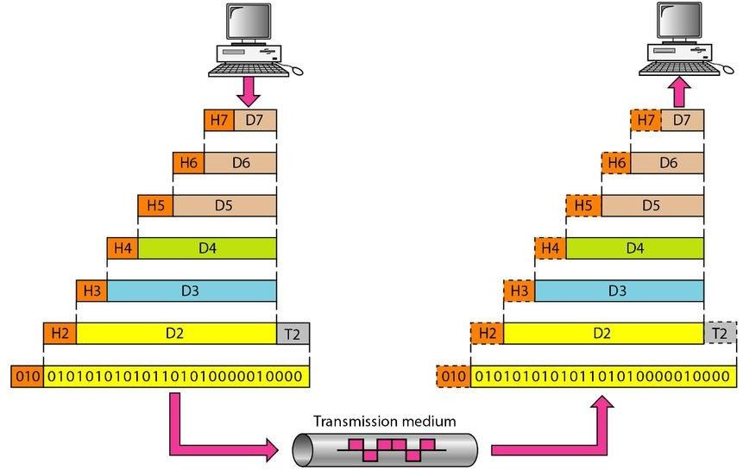
An exchange using the OSI model

Slide 10
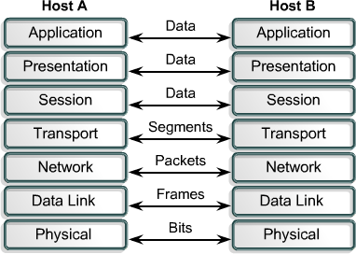
Transformation of Data in OSI layers

Slide 11
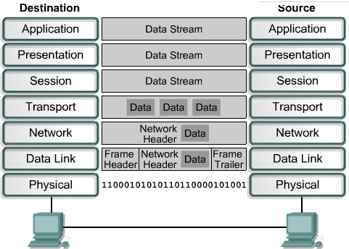
Transformation of Data in OSI layers

Slide 12
Organization of the Layers
Layers 1, 2, and 3 - PHYSICAL, DATA LINK, AND NETWORK.
These are NETWORK SUPPORT LAYERS.
They deal with physical aspects of moving data from one device to another such as
Electrical specifications
Physical connections
Physical addressing
Transport timing
Reliability
Layers 5, 6, and 7 - SESSION, PRESENTATION, AND APPLICATION
It can be thought of as the USER SUPPORT LAYERS.
Layer 4 - TRANSPORT LAYER
It links the two subgroups and ensures that what the lower layers have transmitted is in
a form that the upper layers can use.

Slide 13
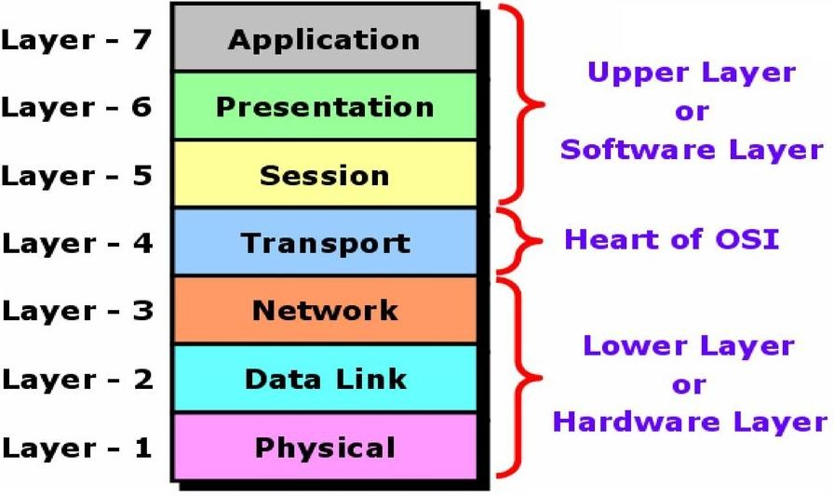
Organization of the Layers
Upper layers are almost always implemented in software.
Lower layers are a combination of hardware and software, except for the physical layer,
which is mostly hardware.

Slide 14
Layer 1: Physical Layer
The physical layer is responsible for movements of individual bits from one hop (node) to the next.
Define physical characteristics of network.
E.g. wires, connector, voltages, data rates, Asynchronous, Synchronous Transmission
Handles bit stream or binary transmission.
Used to maintain, activate and deactivate physical link.
For receiver it reassembles bits and send to upper layer for frames.
For Sender it convert frames
into bit stream and send on transmission medium.

Slide 15
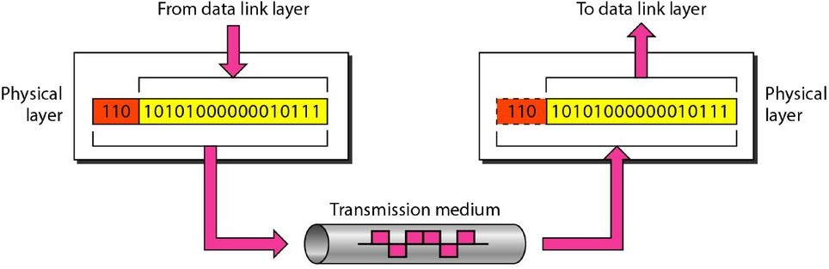
Physical layer
Responsible for movements of individual bits from one hop (node) to the next.
It is concerned with transmitting raw bits over a communication channel.
It deals with mechanical and electrical specifications of interfaces and medium.
It also defines the procedures and functions that physical devices and interfaces have to
perform for transmission to occur.
Devices working at this layer
Hubs
Repeaters
Cables
Modems, etc.,

Slide 16
Other responsibilities of the Physical layer
Physical characteristics of interfaces and medium
Defines characteristics of interface between devices and transmission medium.
Defines type of transmission medium.
Representation of bits
Data consists of a stream of bits (sequence of 0s or 1s) with no interpretation.
To be transmitted, bits must be encoded into signals-- electrical or optical.
Defines the type of encoding (how 0s and 1 s are changed to signals).
Data rate
Number of bits sent per second.

Slide 17
Other responsibilities of the Physical layer
Synchronization of bits
Sender and receiver must use the same bit rate and also must be synchronized at the bit level.
Sender and receiver clocks must be synchronized.
Line configuration
Concerned with the connection of devices to the media.
In a point-to-point configuration, two devices are connected through a dedicated
link.
In a multipoint configuration, a link is shared among several devices.

Slide 18
Other responsibilities of the Physical layer
Physical topology
It defines how devices are connected to make a network.
Devices can be connected by using a
Mesh topology
Every device is connected to every other device
Star topology
Devices are connected through a central device
Ring topology
Each device is connected to the next, forming a ring
Bus topology
Every device is on a common link
Hybrid topology
Combination of two or more topologies

Slide 19
Other responsibilities of the Physical layer
Transmission mode
Layer also defines the direction of transmission between two devices:
Simplex mode
Only one device can send; the other can only receive.
It is a one-way communication.
Half-duplex mode
Two devices can send and receive, but not at the same time.
Full-duplex (or simply duplex) mode,
Two devices can send and receive at the same time.

Slide 20
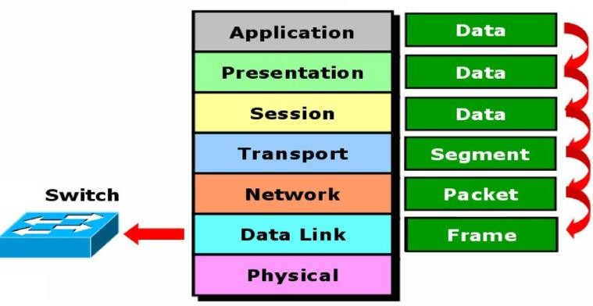
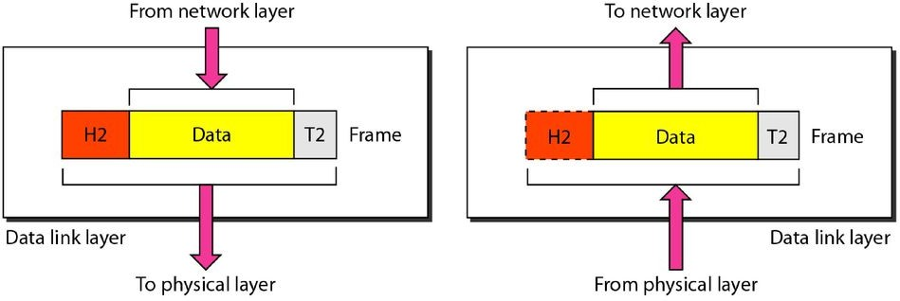
Data link layer
It is responsible for moving frames from one hop (node) to the next.
Headers and trailers are added.
Devices working at this layer
Switch
Bridge
NIC

Slide 21
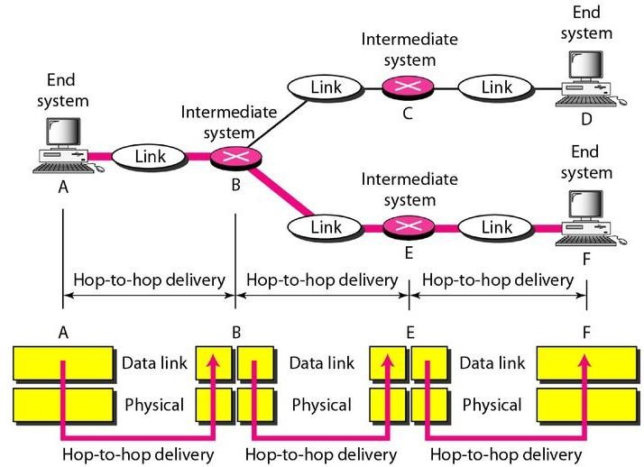
Hop-to-hop delivery/ Node-to-Node delivery

Slide 22
Responsibilities of Data link layer
Framing- Stream of bits from network layer is divided into manageable unit called FRAMES
Physical Addressing-Data Link Layer adds a header to the frame to define physical address [ address of Sender and Receiver is placed in the header].

Slide 23
Responsibilities of Data link layer
Flow control- Speed at which the sender sends and receiver receivers the data
should be balanced.
Error control
Mechanisms to detect and retransmit damaged or lost frames.
Mechanism to recognize duplicate frames.
Error control is achieved through a trailer added to the end of the frame.
Access control
When two or more devices are connected to the same link, layer determines which device has control over the link at any given time.

Slide 24
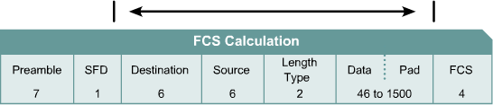
Layer 2 Frames
Frames include information about:
Which computers are in communication with each other.
When communication between individual computers begins and when it ends.
Which errors occurred while the computers communicated (LLC)

Slide 25
Sub layers of Layer 2
Logical link layer (LLC)
Used for communication with upper layers
Error correction
Flow control
Media Access Control (MAC)
Access to physical medium
Header and trailer

Slide 26
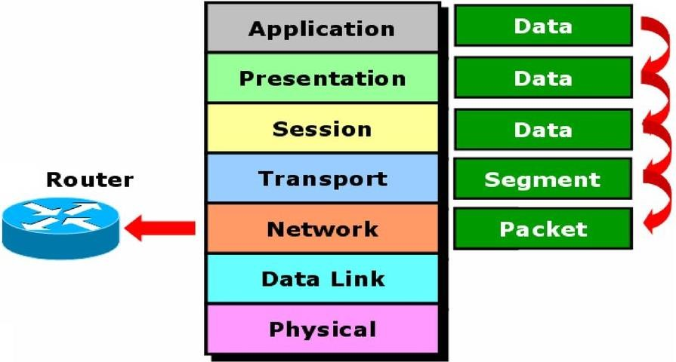
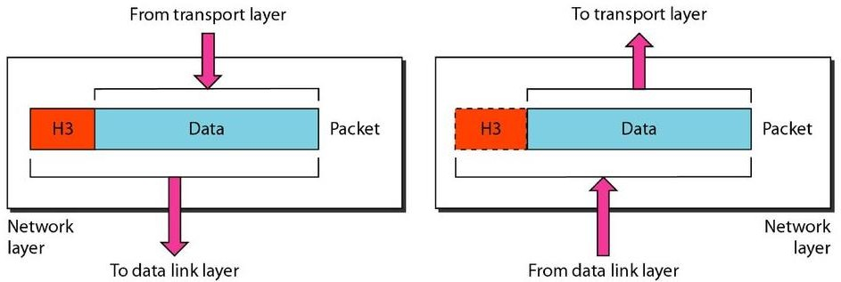
Network layer
The network layer is responsible source to the destination delivery of packets across multiple networks.
Provide switching and routing facilities.
Determines network address and best path to
deliver packets.
Protocols that operates at layer 3:
IP, ARP,RARP, ICMP,
Layer 3 Devices:
Routers,
ATM switches.

Slide 27
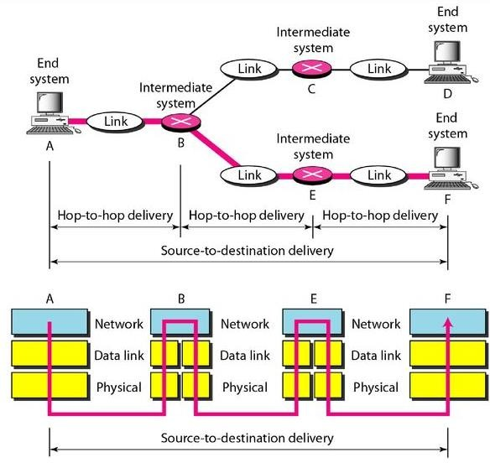
Source-to-destination delivery

Slide 28
Responsibilities of Network layer
Logical addressing
If a packet passes the network boundary we need another addressing system to help
distinguish the source and destination systems.
Layer adds a header to the packet. It includes the logical addresses of the sender and
receiver.
Routing
When independent networks or links are connected to create internetworks (network of networks) or a large network, the connecting devices (called routers or switches) route or switch the packets to their final destination.

Slide 29
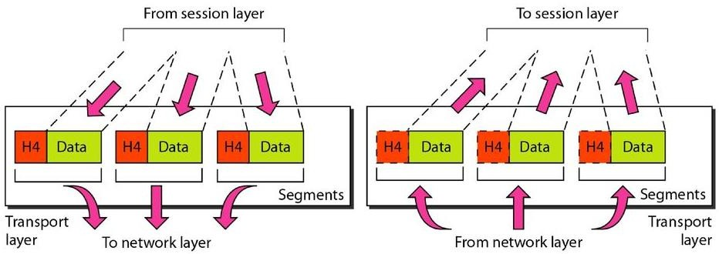
Transport layer
It is responsible for the delivery of a message from one process to another (end-to-end).
Provides QoS
Whole message is received in order.
Converts data into segments.
Ensures data is delivered error free.
Protocols at layer 4: TCP, ARP,RARP, UDP
Layer 4 Network component: Gateways

Slide 30
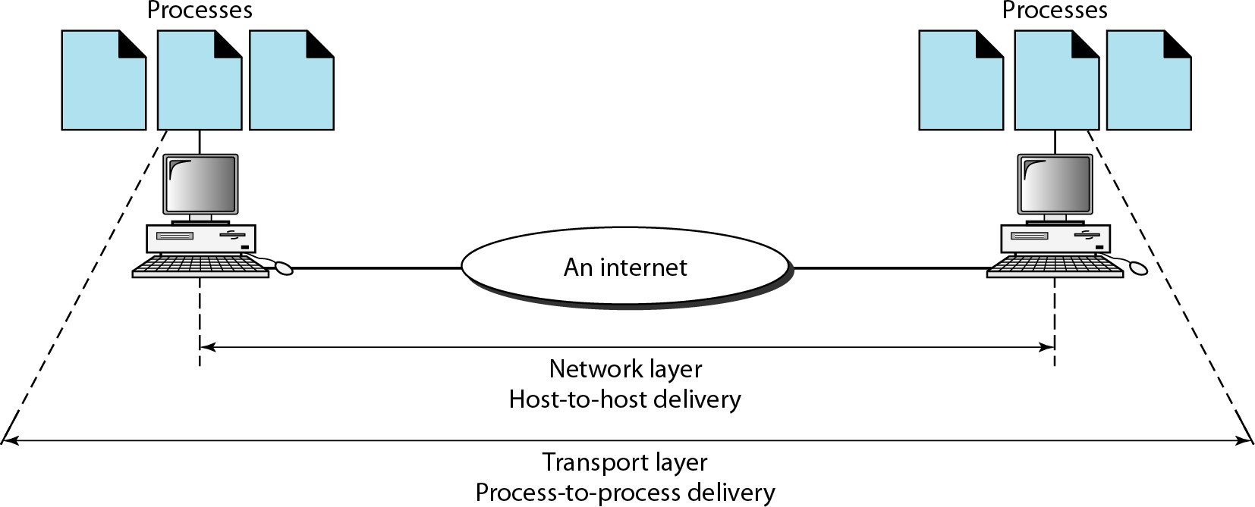
Process-to-Process / End-to-End delivery

Slide 31
Responsibilities of Transport Layer
Service point addressing
Port address is necessary for delivering the packets .
Segmentation and reassembly
Message is divided into transmittable segments each containing a sequence no. Receiver reassemble the segment in order to get the entire message.
Connection control- Connectionless / connection oriented.
Flow control
Error control

Slide 32
Session Layer
Used for dialogue control and synchronization purposes.
Establishes sessions between systems.
Dialog control:
Allows two systems enter into a dialog( either half or full duplex mode).
Synchronization:
Add check points (synchronization points) to stream of data.
If session fails only send that data which was not delivered not whole message.
E.g. files of 2000MB

Slide 33
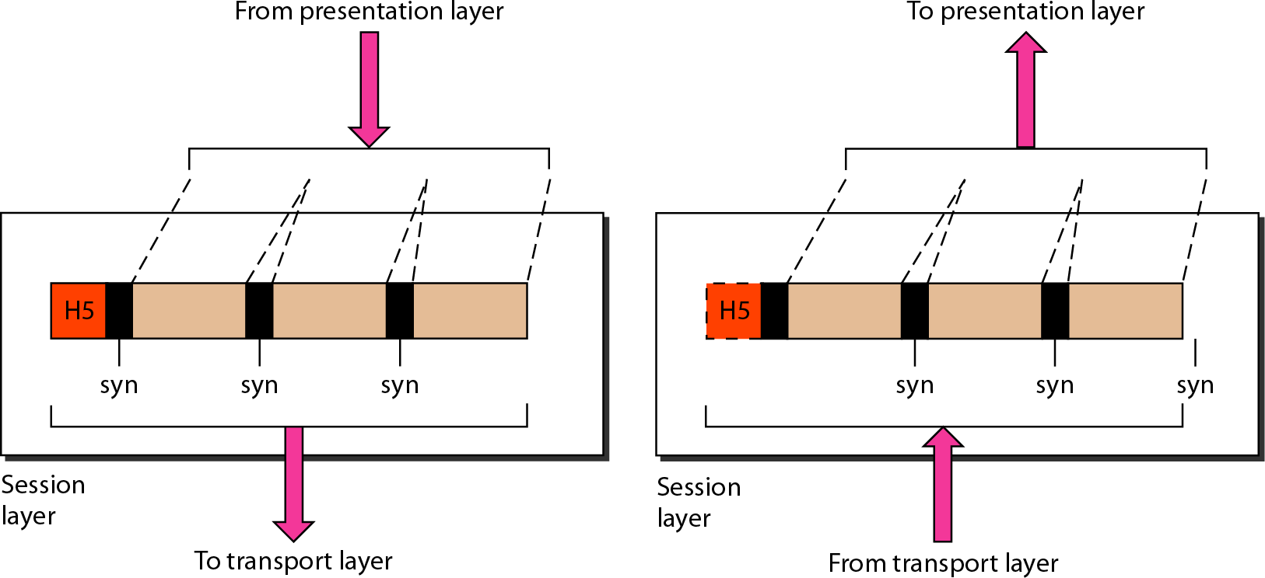
Session Layer

Slide 34
Presentation Layer
Concerned with syntax and semantics of information.
Responsibilities of Presentation Layer: Translation, encryption.
compression, and
Translation: data into bits and selecting appropriate encoding technique and changing from sender format to receiver format.
Compression: Reduce number of bits.

Slide 35
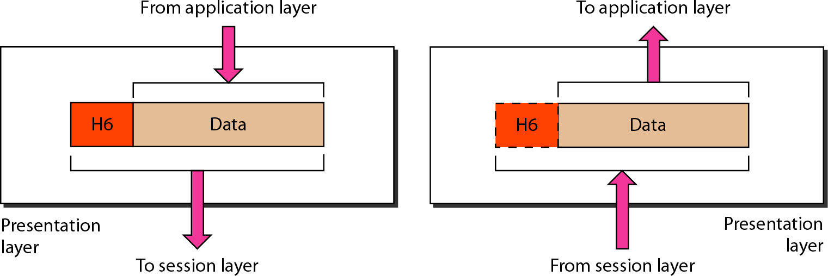
Presentation Layer

Slide 36
Application Layer
Responsible for providing services to the user to access the network.
Network Virtual Terminal (Remote desktop)
Allows user to log on to a remote host.
File Transfer, access and management (FTAM)
Allows user to control files in the remote system.
Mail services
Email forwarding and storage
Directory Services
Provides distributed database sources and access for global information about various objects and services.

Slide 37
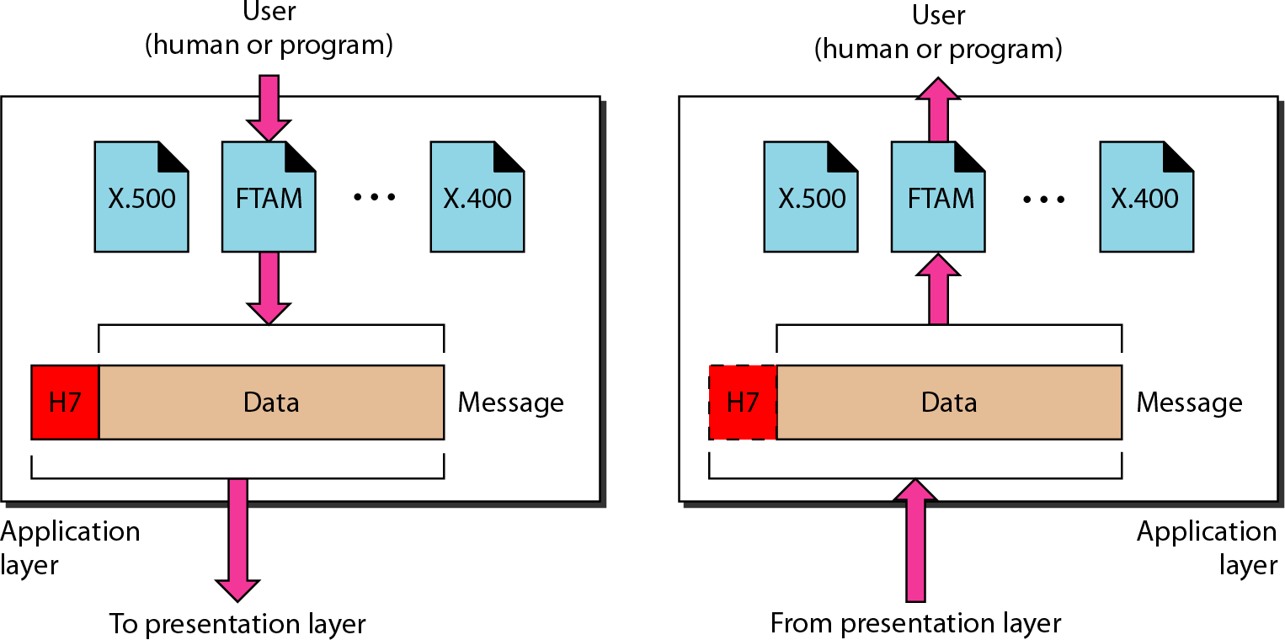
Application Layer

Slide 38
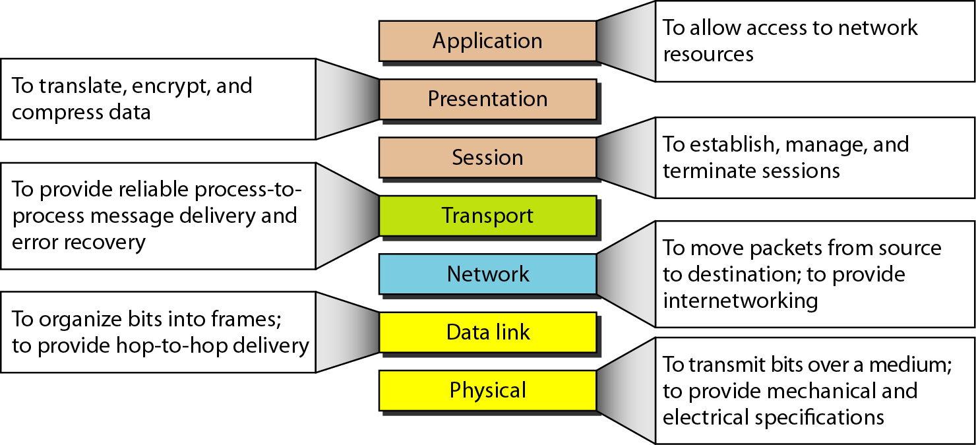
Summary of layers

Slide 39
Advantages of OSI
Network communication is broken into smaller, more manageable parts.
Allows different types of network hardware and software to communicate with each other.
All layers are independent and changes does not affect other layers.
Easier to understand network communication.

